Slide 1
Automated HTML layout generator

Slide 2
Problem statement
Converting a graphical user interface into computer code is a difficult task for developers in order to build websites and mobile applications.
Writing code for layout takes more time.

Slide 3
Tools
List of tools are:
webflow
Adobe reflow
Export kit
Napkee
Adobe dreamweaver
pix2code
Sketch2code

Slide 4
Deep learning method
Automated HTML code generator with deep learning is used to convert image layouts into working HTML code.
This system uses deep learning methods to convert image layouts into HTML code.
The system provides option to developers to choose between bootstrap or media queries.
It produces responsive webpages and it can adapt between mobile, tablet and desktop screens.

Slide 5
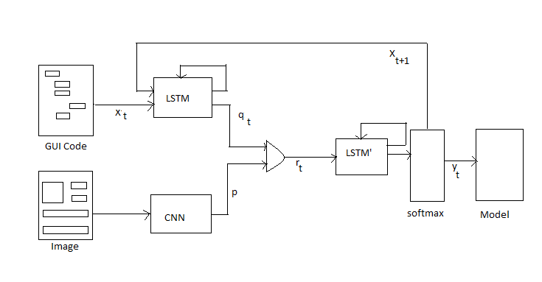
Training work flow

Slide 6
Training
The training layout images are preprocessed using the image processing techniques.
During training, the image and the corresponding GUI code is fed into Neural network to perform image recognition and captioning.
Computer vision is done by Convolutional Neural Network (CNN).
Recurrent Neural Network (RNN) performs language modeling on the textual description associated with the input picture.
The final model is generated using the trained datasets.

Slide 7
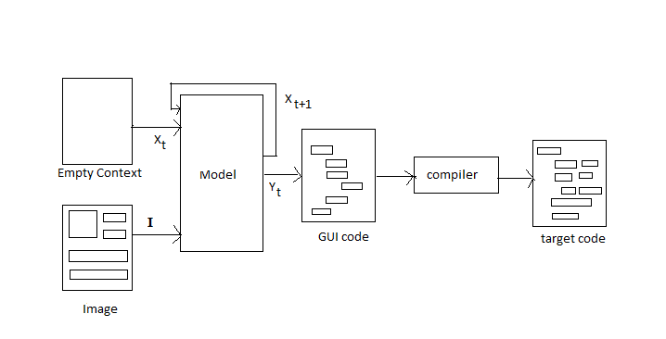
Sampling work flow

Slide 8
Sampling
The image to be tested is feed into the pre-trained model.
The generated model and the weights are used to extract the features from the given image.
During sampling, the input GUI is updated for each prediction to contain the last predicted token.
The resulting sequence of DSL tokens is compiled to the desired target language using traditional compiler design techniques.

Slide 9
Compilation
During compilation phase, the GUI code generated is converted into the HTML code by compiler design techniques.
This is done by mapping tokens to their corresponding code in the JSON mapping file.
The HTML code generated is responsive and this can be done in two ways. One is done by using Bootstrap and another one is by using Media Queries.
Developers can take advantage of CSS classes defined in Bootstrap to further customize the appearance of their contents.

Slide 10
Additional features
Responsive output- Bootstrap, CSS3
Platform specific output- desktop, tablet and mobile

Slide 11
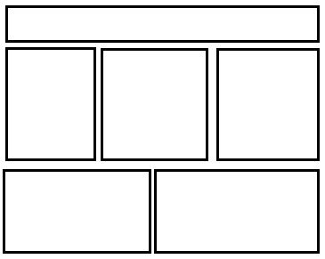
Training image

Slide 12
Corresponding GUI code used for training:
header {
}
row {
triple {
}
triple {
}
triple {
}
}
row {
double {
}
double {
}
}

Slide 13
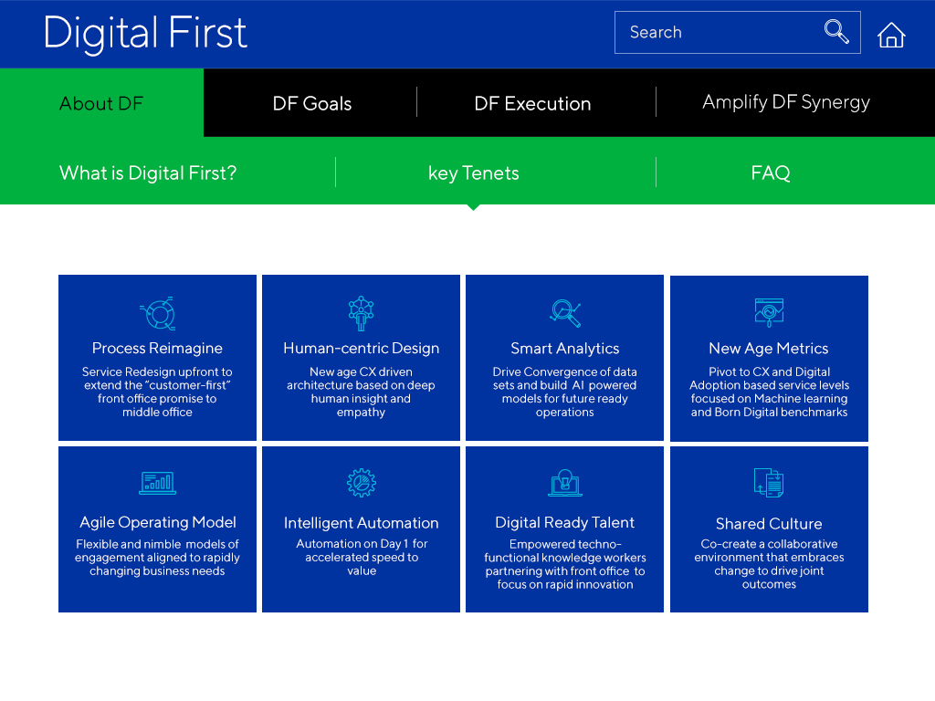
Original Image

Slide 14
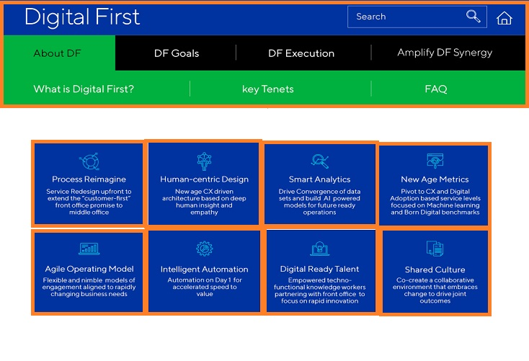
Identified Layout

Slide 15
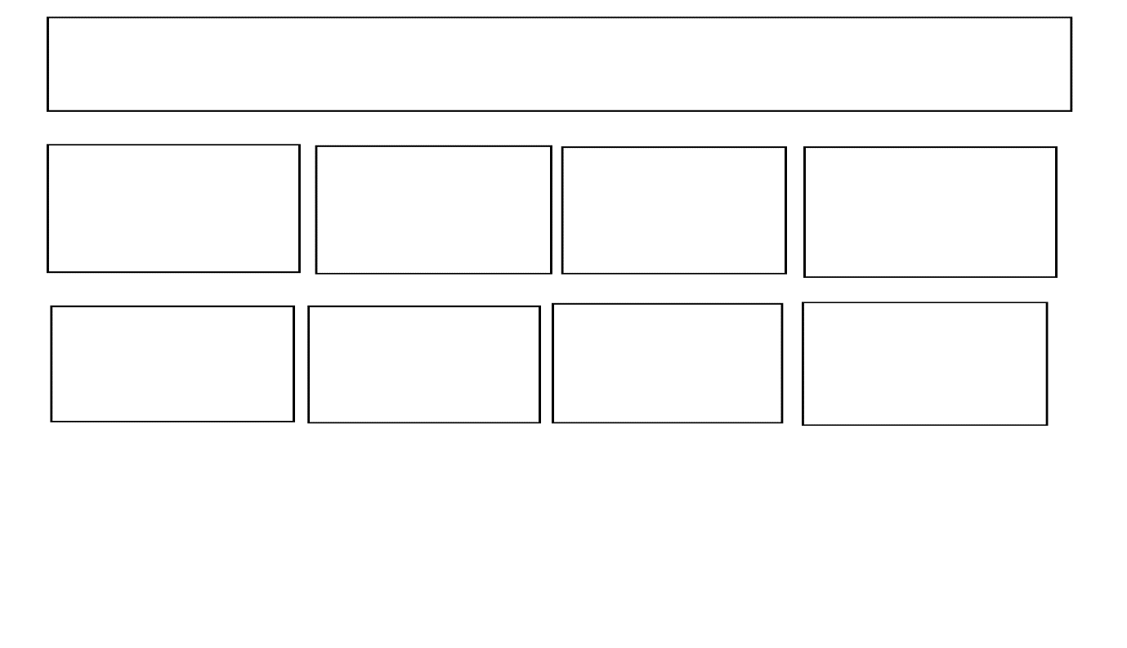
Input Image from identified layout

Slide 16
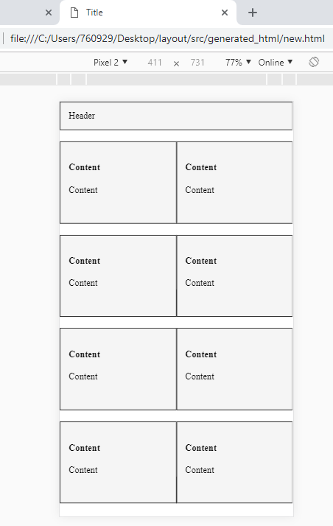
Generated layout for mobile view

Slide 17
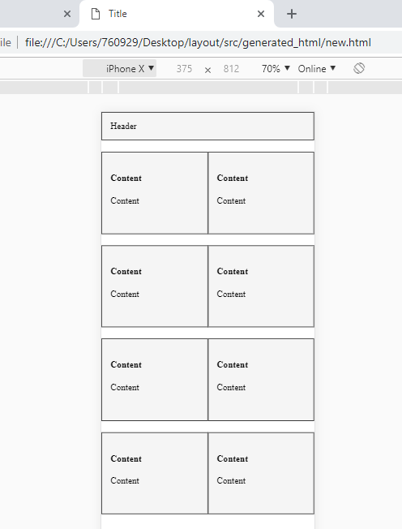
Generated layout for tablet view

Slide 18
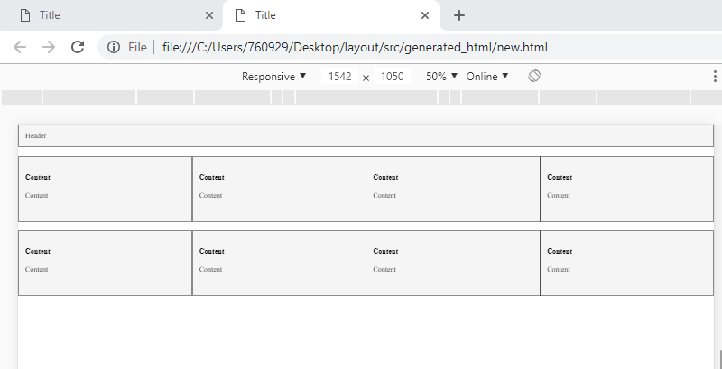
Generated layout for desktop view

Slide 19
Thank you

